Slide 1
Customer Lifetime Value Dashboard
Presented by:
Muthuvalli

Slide 2
Problems
Difficulty Understanding Long-Term Customer Value
Lack of a Unified Customer View
Focus on Short-Term Sales Instead of Long-Term Relationships
Difficulty Identifying High-Value Customers
Difficulty Understanding Customer Retention
Ineffective Customer Segmentation
Lack of an Interactive Customer Analysis System

Slide 3
Solutions
Calculate Customer Lifetime Value
Calculate each customer's revenue, orders, purchase frequency, and average order value.
Use these measures to understand the overall value of each customer.
This helps the business focus on long-term customer value instead of individual sales.
Create a Unified Customer View
Bring customer and transaction information together in one customer view.
Understand each customer's purchases, revenue, and overall value in one place.
This makes customer analysis easier and more complete.

Slide 4
Analyze Customer Behavior Over Time
Track revenue, orders, purchases, and customer value over time.
Understand how customer purchasing behavior changes over different periods.
This helps the business make better decisions based on customer trends.
Segment Customers by Lifetime Value
Divide customers into High, Medium, and Low-value groups.
Compare these groups based on customers, revenue, orders, and purchase behavior.
This helps the business create different strategies for different customer groups.

Slide 5
Analyze Customer Retention
Identify repeat, one-time, active, and inactive customers.
Track how customer purchasing behavior changes over time.
This helps the business retain existing customers and bring inactive customers back.
Enable Customer-Level Analysis
Allow users to move from overall business → customer segment → individual customer.
View each customer's revenue, orders, last purchase, frequency, and CLV.
This helps the business understand individual customers and take targeted action.

Slide 6
Dataset Details
Data Source: Kaggle – CRM Analytics (CLTV)
Author: Halime Dogan
Dataset: Online Retail II
Source: Kaggle

Slide 7
Columns
Invoice: Invoice number.
StockCode: Product code.
Description: Product name
Quantity: Number of products. It expresses how many of the products on the invoices have been sold.
InvoiceDate: Invoice date and time.
UnitPrice: Product price (in GBP)
CustomerID: Unique customer number
Country: The country where the customer lives.

Slide 8
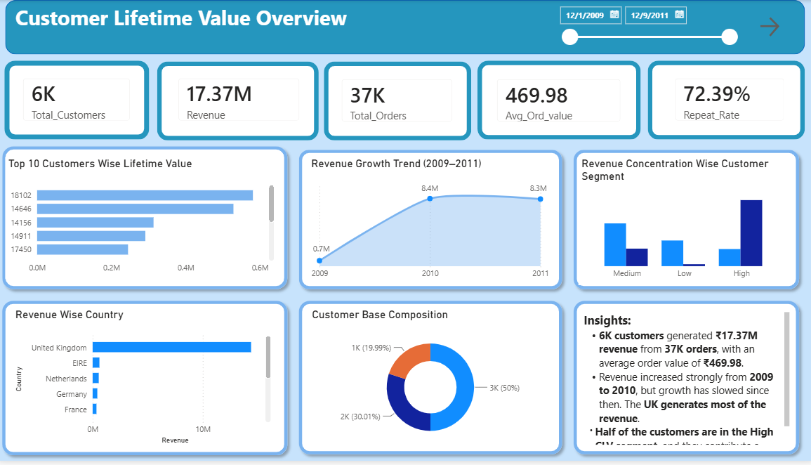
Dashboard

Slide 9
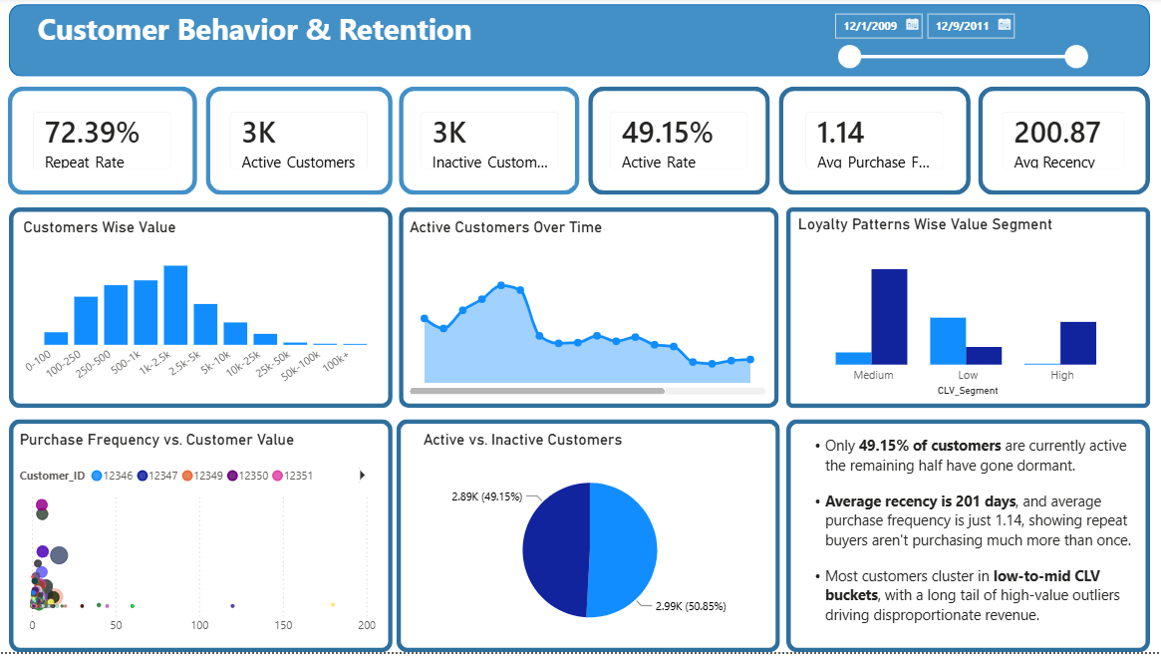
Page 2

Slide 10
Thank you

